Slide 1
Electroencephalography (EEG)
Introduction of EEG and first steps into data visualization and handling using FieldTrip (Matlab).

Slide 2
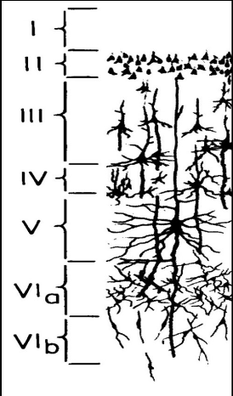
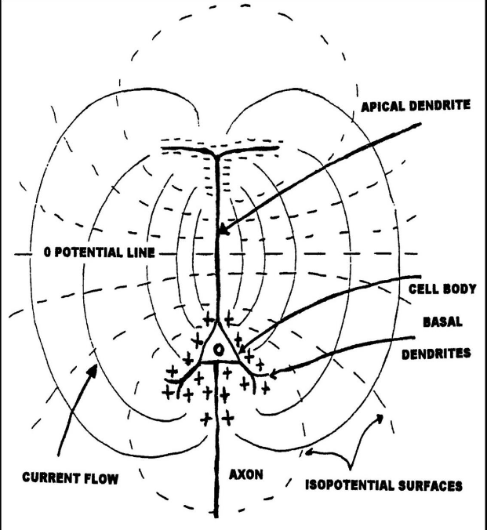
Where does the signal come from?
EEG signal is generated by pyramidal neurons located (mostly) in layers IV, V and VI of the cortex.
A large population of neurons must be active for the electrodes to detect any sort of signal.
These neurons must be aligned so that their potential do not cancel out. Pyramidal neurons are vertically aligned in the cortex (this is not true for sub-cortical regions).
Pyramidal neurons
Current flow from soma to dendrites
Notes:
EEG measures the electrical signal generated from the brain at the scalp.
The electrical signal that is detectable through EEG is mostly generated by pyramidal cells, of which the soma (the centre, the nucleus) is located in layer IV, V and VI of the cortex.

Slide 3
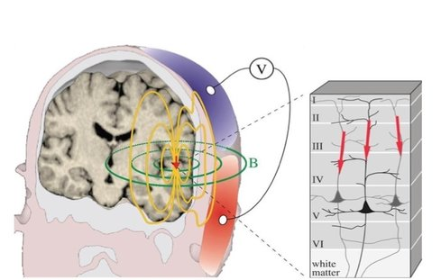
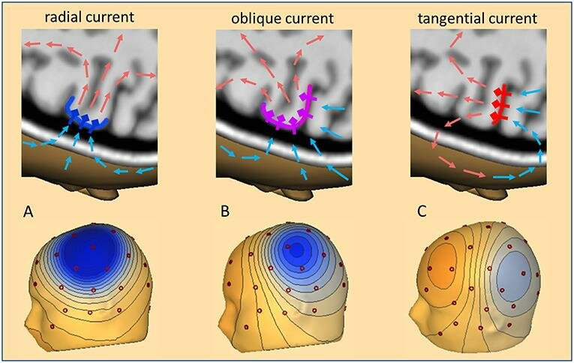
Where does the signal come from?
-
+

Slide 4
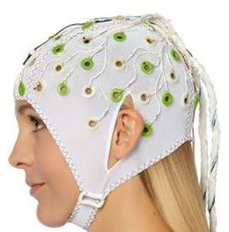
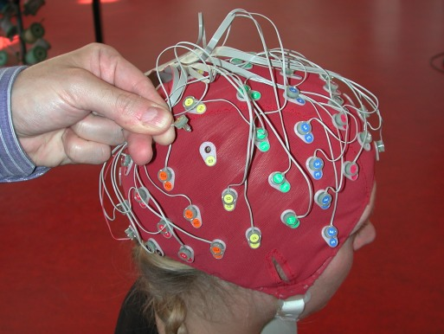
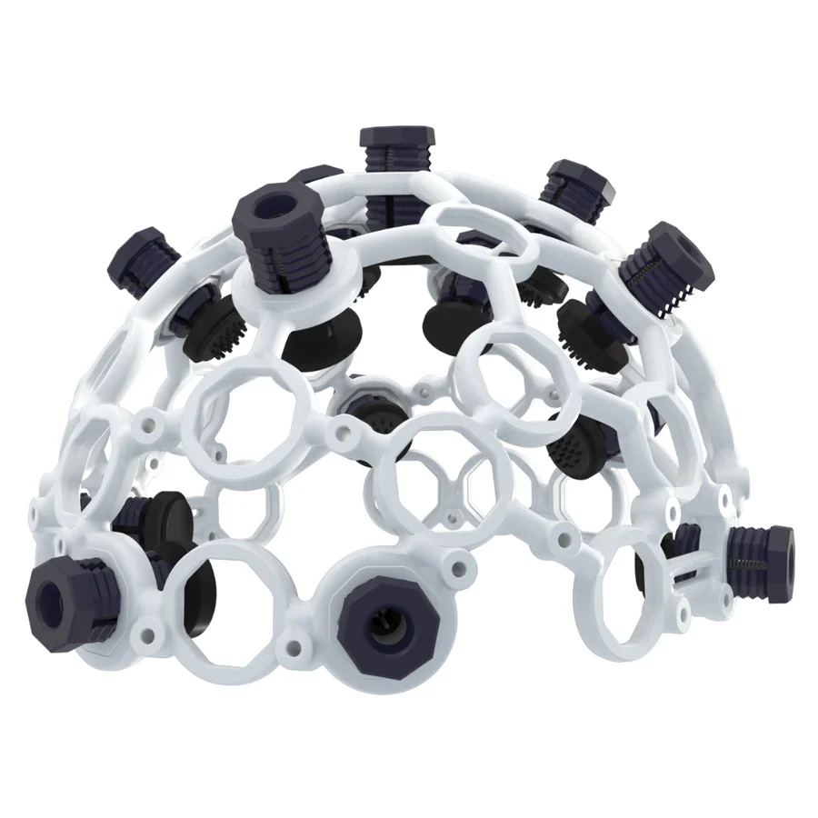
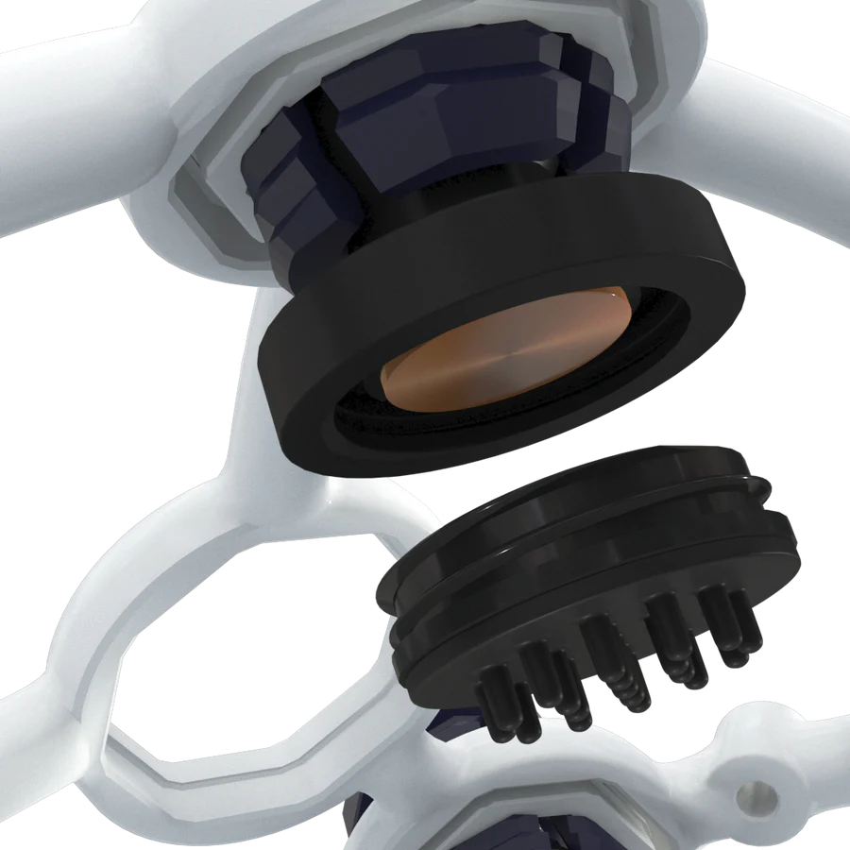
How to measure a signal (electrodes)
Gel electrodes
Dry electrodes
Active electrodes
Passive electrodes
BrainProducts
BioSemi
OpenBCI
Notes:
Gel electrodes → require the application of a conductive substance to minimize the impedance between the electrode and the scalp.
Dry electrodes → do not require the application of a conductive paste or gel. They try to obtain a better signal by modifying the electrode shape (e.g., comb-like, bristle-like, multi-pin and so on) and the substance (inert conductive materials) but they tend to be more instable bc of impendance issues.
Passive electrode → usually they have only one wire. They are applied to the scalp using gel or paste (conductive) after light abrasion to reduce electrode-scalp impedance.
Active electrode → easier to install (much less time). Signal already amplified at electrode source, therefore minimizing ambient noise or artifacts due to cable movement.

Slide 5
How to measure a signal (cap)

Slide 6
How to measure a signal (reference)

Slide 7
EEG data visualisation

Slide 8
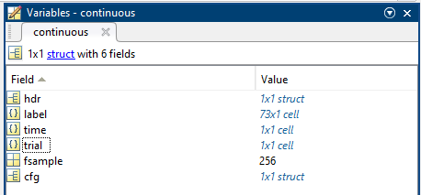
In Matlab
%% Add the fieldtrip path
%addpath('C:/Users/nnu02/Documents/MATLAB/fieldtrip-20220827');
folder = 'C:\Users\nnu02\Desktop\Gian_EEGvisualisation_handling\';
%% Load the raw dataset
cfg = [];
cfg.dataset = strcat(folder, '24_exp_SPN-Cropped.bdf');
continuous = ft_preprocessing(cfg);
% Downsample so it's more manageable
cfg = [];
cfg.resamplefs = 256;
continuous = ft_resampledata(cfg, continuous);
Notes:
Load the dataset and explore the structure

Slide 9
In Matlab
%% Open the raw dataset
cfg = [];
ft_databrowser(cfg, continuous);
Notes:
Look at the data!

Slide 10
Background (Nyquist theorem)
%% NYQUIST FREQUENCY
%you need to sample at twice the frequency of interest: frequency at half
%of the sampling rate can be recovered.
time = -1:0.0001:1;
A = 2;
figure;
plot(time, A*sin(2*pi*2*time));
hold on
time = -1:0.01:1; %sampling 100Hz
plot(time, A*sin(2*pi*2*time), 'r*')
time = -1:0.5:1; %sampling 2Hz
plot(time, A*sin(2*pi*2*time), 'b*')
legend({'Wave at 2Hz', 'Sampling at 100Hz', 'Sampling at 2Hz'})

Slide 11
Background: Linear summation

Slide 12
Background: Linear summation

Slide 13
EEG pre-processing
Re-referencing and high pass filtering

Slide 14
Re-reference (offline)
The reference influences the amplitude at each EEG channel and time point: it defines the level of zero voltage and all other channels are expressed in relation to it.
→ EEG channel / external channel reference → each electrode time-course is subtracted of the time-course of one electrode (either EEG electrode or an external channel, usually placed on the mastoid or earlobes). The “zero” is determined by electrodes placed on top of head positions with virtually no brain signal.
→ Average reference → each electrode is subtracted of the time-course of the average electrical activity from all electrode. In this way, the sum of all electrodes at each time point is zero. Each channel contributes equally to determine what is the “zero”.

Slide 15
High pass filtering to remove big drifts

Slide 16
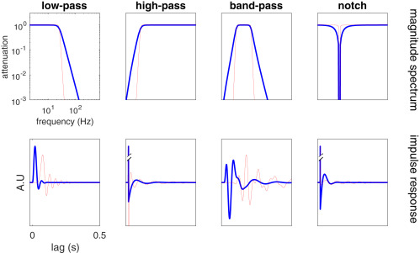
High pass filtering to remove drifts

Slide 17
After High-pass filter

Slide 18
In Matlab
%% Try to adjust it a bit :)
cfg = [];
cfg.reref = 'yes';
cfg.refchannel = 'EEG';
cfg.hpfilter = 'yes'; %HPF
cfg.hpfreq = 0.1; %HPF = 0.1 Hz
cfg.hpfilttype = 'but'; %Butterworth
cfg.hpfiltdir = 'twopass'; %Two-pass filter
cfg.hpinstabilityfix = 'reduce
cfg.padding = size(continuous.trial{1,1},2)/continuous.fsample +100*2;
continuous_reref_hpf = ft_preprocessing(cfg, continuous);
cfg = [];
cfg.continuous = 'yes';
cfg.ylim = [-20 20];
cfg.blocksize = 5;
cfg.channel = 1:64;
ft_databrowser(cfg, continuous_reref_hpf);

Slide 19
EEG pre-processing
Epoching

Slide 20
In Matlab
%% Epoching!
%First let's have a look at our events of interest
cfg = [];
cfg.dataset = dataset;
cfg.trialfun = 'ft_trialfun_general'; % this is the default
cfg.trialdef.eventtype = 'STATUS';
cfg.trialdef.eventvalue = 128; % the values of the stimulus
prova = ft_read_event(dataset);
for i = 1:length(prova)
prova(i).sample = round(prova(i).sample/8);
end
continuous_reref_hpf.cfg.previous = rmfield(continuous_reref_hpf.cfg.previous, …
'origfs');
cfg = [];
cfg.event = prova;
cfg.plotevents = 'yes';
cfg.continuous = 'yes';
cfg.ylim = [-20 20];
cfg.blocksize = 5;
cfg.channel = 1:64;
ft_databrowser(cfg, continuous_reref_hpf);

Slide 21
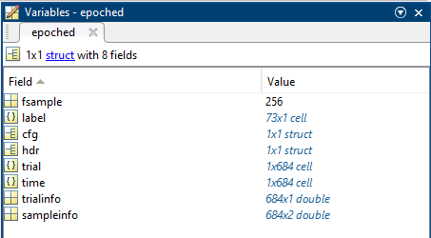
In Matlab
%Then do proper epoch
trl = [];
cfg = [];
cfg.dataset = dataset;
cfg.trialfun = 'ft_trialfun_general'; % this is the default
cfg.trialdef.eventtype = 'STATUS';
cfg.trialdef.eventvalue = 128; % the values of the stimulus
cfg.trialdef.prestim = 0.1; % in seconds
cfg.trialdef.poststim = 0.5; % in seconds
cfg = ft_definetrial(cfg);
trl = cfg.trl;
cfg = [];
cfg.trl = trl;
cfg.trl(:,1:3) = round(cfg.trl(:,1:3)/8);
epoched = ft_redefinetrial(cfg, continuous_reref_hpf);
cfg = [];
cfg.ylim = [-20 20];
cfg.channel = 1:64;
ft_databrowser(cfg, epoched);

Slide 22
EEG pre-processing
Artifact rejection and detection

Slide 23
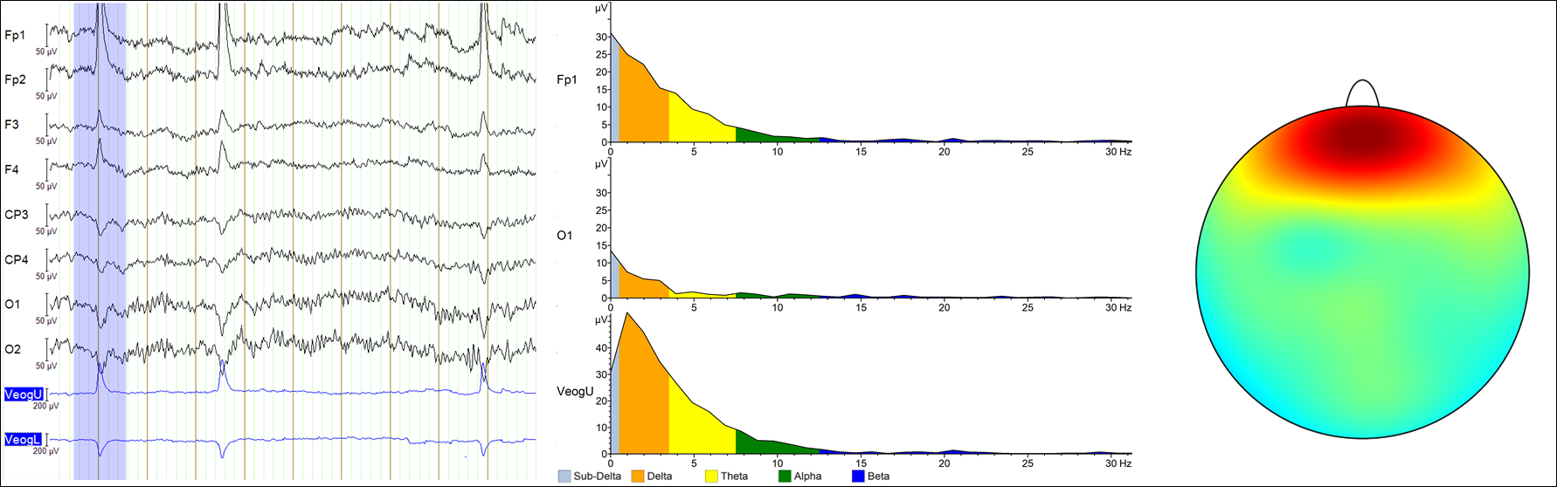
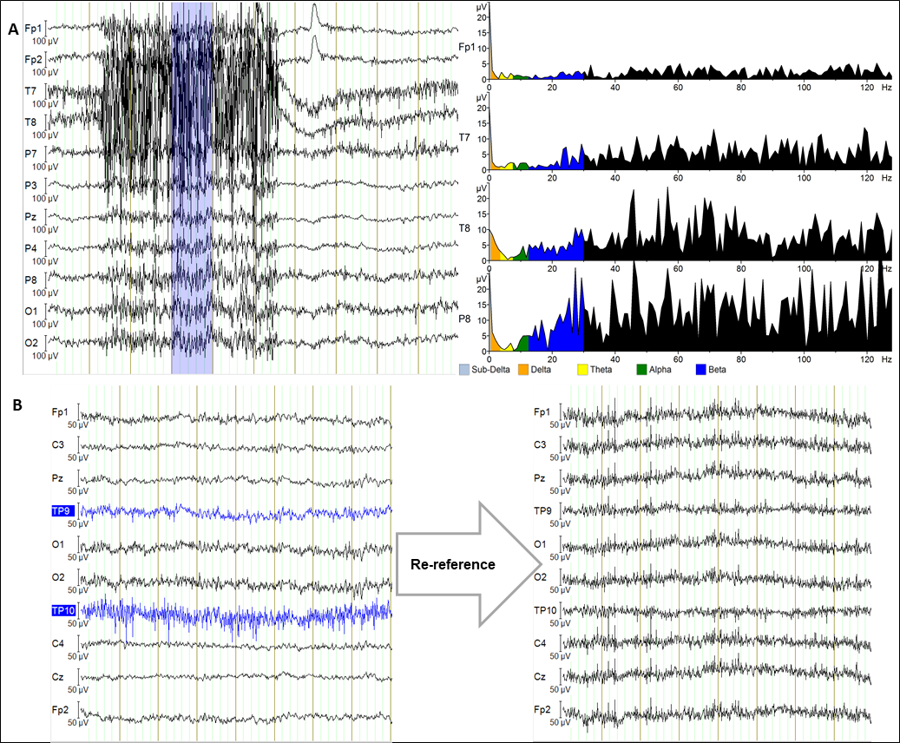
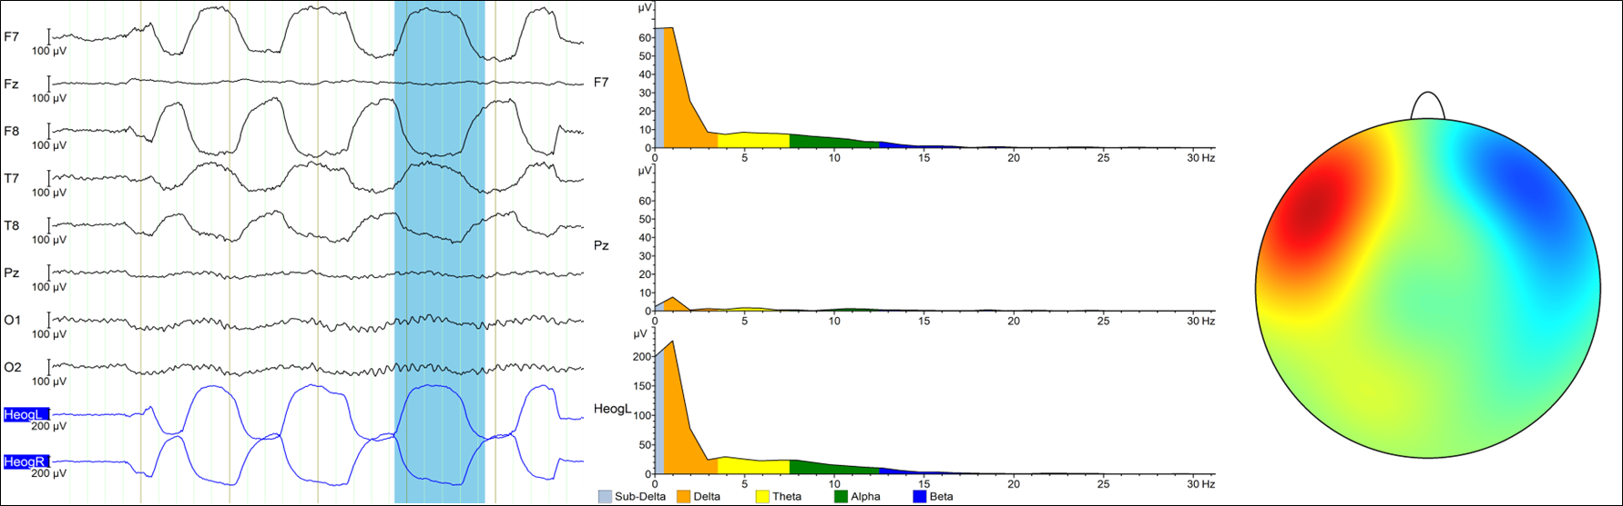
Artifacts (physiological)
Eye blink (vertical eye movements)
Muscle artifact
Horizontal eye movements
Source: BrainProducts website

Slide 24
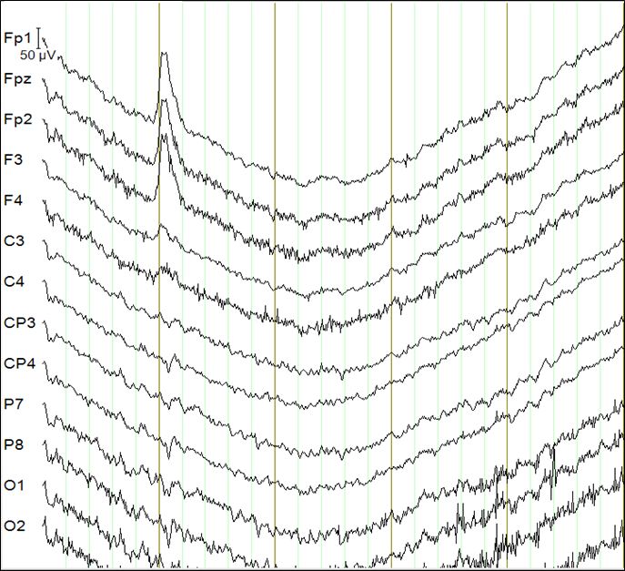
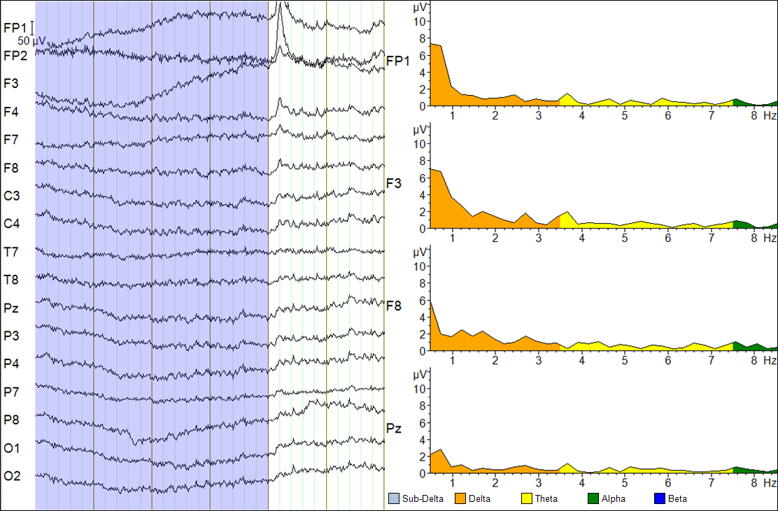
Artifacts (physiological)
Body movement
Sweat artifact
Source: BrainProducts website

Slide 25
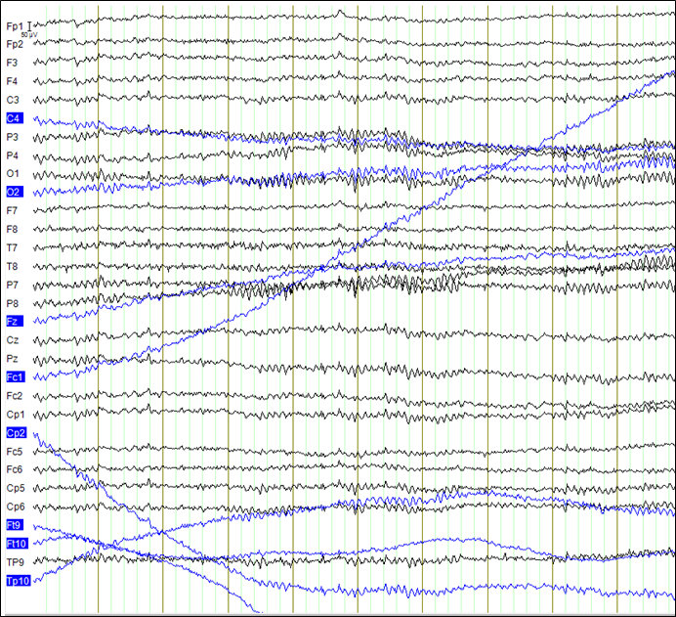
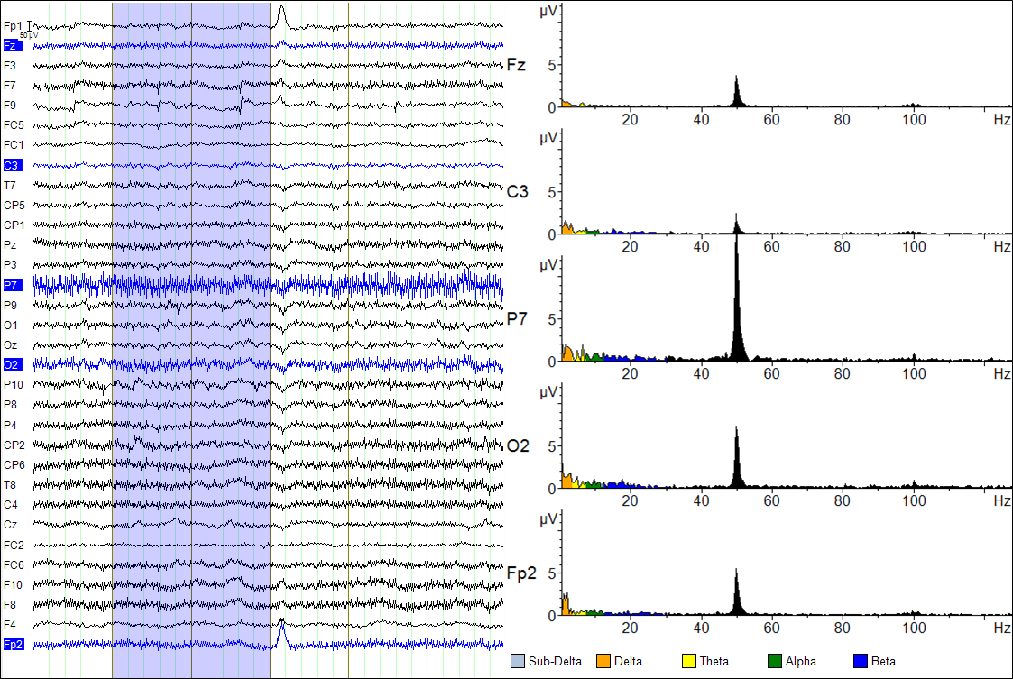
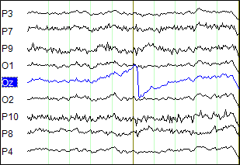
Artifacts (technical)
Loose electrode contact
Line noise (50/60 Hz)
Electrode pop
Source: BrainProducts website

Slide 26
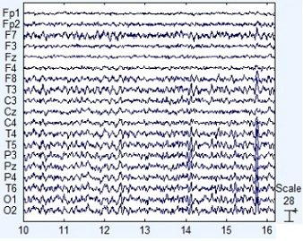
Prototypical signal

Slide 27
In Matlab
%% TRIAL REJECTION
load("visual.mat")
cfg = [];
cfg.ylim = [-20 20];
cfg.channel = 1:64;
cfg.artfctdef.visual.artifact = visual;
artifact = ft_databrowser(cfg, epoched);
visual = artifact.artfctdef.visual.artifact;
save("visual.mat", "visual"); %save and load every time we run this section.
cfg = [];
cfg.artfctdef.reject = 'complete'; %complete removal of trials contaminated
cfg.artfctdef.visual.artifact = visual;
cleaned_epoched = ft_rejectartifact(cfg, epoched);
Example of automated artifact detection toolboxes: FieldTrip, PREP Toolbox, AutoMagic, CleanRawData, ASR.

Slide 28
EEG pre-processing
Time-locking. Our first ERPs!

Slide 29
Background: signal and noise (time-locked signal, evoked signal).
time = -1:0.01:1; %
A = 3;
signal = A*sin(2*pi*1*time);
noise = rand(1,1)*A*sin(2*pi*rand(1,1)*10*time);
total_noise = [];
for i = 1:100 %change to 10 and 100 and see the difference.
noise = A*sin(2*pi*rand(1,1)*5*time + 100*rand(1,1));
noise = signal + noise;
total_noise = [total_noise; noise];
end

Slide 30
In Matlab
%% AVERAGE OVER TRIALS
cfg = [];
cfg.channel = 1:64;
ERP = ft_timelockanalysis(cfg, cleaned_epoched);
cfg = [];
cfg.ylim = [-0.5 0.5];
ft_databrowser(cfg, ERP);
cfg = [];
cfg.ylim = [-8 8];
cfg.viewmode = 'butterfly';
ft_databrowser(cfg, ERP);

Slide 31
In Matlab
%% AVERAGE OVER TRIALS
cfg = [];
cfg.channel = 1:64;
ERP = ft_timelockanalysis(cfg, cleaned_epoched);
cfg = [];
cfg.ylim = [-0.5 0.5];
ft_databrowser(cfg, ERP);
cfg = [];
cfg.ylim = [-8 8];
cfg.viewmode = 'butterfly';
ft_databrowser(cfg, ERP);

Slide 32
Something missing?! Baseline correction
Baseline is a period (usually pre-stimulus) free of any other stimulation (nothing was happening).
Baseline linearly sums with the post-stimulus activity (our epoch of interest) (see alternative: Alday 2019).
Baseline length needs to be as long as the interfering activity that we assume is shifting our signal.
Notes:
Even though we re-reference and high-pass filtered our signal, one could assume that “when nothing was happening, then our signal must be zero”. This is definitely not the case in the data so far.
There will always be some temporal drifts or channel specific voltages that we can’t “take out” by simply high-pass filtering and re-referencing.
Solution? BASELINE CORRECTION.
Assumption → baseline is a period (usually before the onset of the stimulation) where the electrophysiological activity is free of any other stimulation (“flat”)

Slide 33
In Matlab
%% BASELINE
cfg = [];
cfg.demean = 'yes';
cfg.baselinewindow = [-0.1 0];
ERP_baseline = ft_preprocessing(cfg, ERP);
cfg = [];
cfg.ylim = [-8 8];
cfg.viewmode = 'butterfly';
ft_databrowser(cfg, ERP_baseline);

Slide 34
ERP exploration
Somatosensory Evoked Potential (SEP)

Slide 35
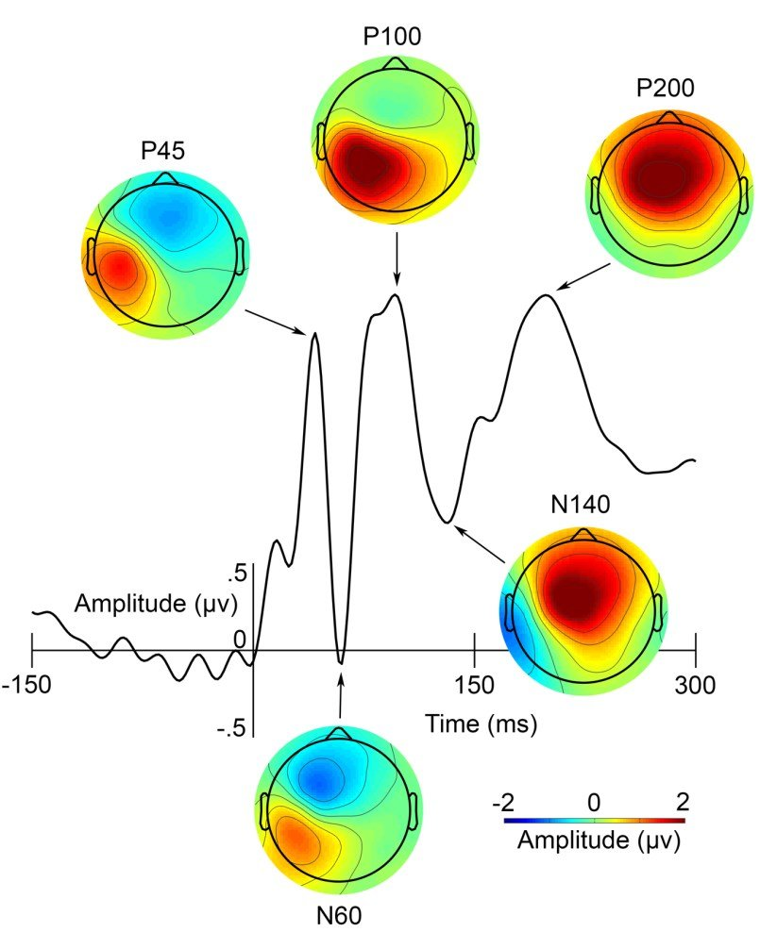
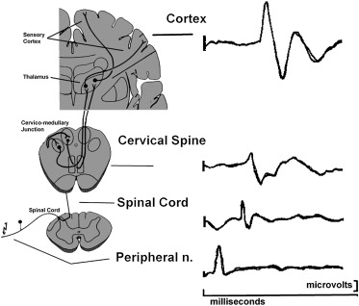
Background: SEP, what to expect
Miller et al., 2019

Slide 36
In Matlab
%% EXPLORATION OF THE RESULTS
caplocation = strcat(folder, 'biosemi64.lay');
cfg = [];
cfg.layout = caplocation;
ft_multiplotER(cfg, ERP_baseline)

Slide 38
Thank you for your attention!

